Slide 1
FIFA PLAYER DATA ANALYSIS
Varun Muralidharan (VXM180016)
Karthick Ganesan (KXG170003)
Abhinandan Mohan Raj (AXM180090)
Parthasarathy Sundar Karthikeyan (PXS180018)

Slide 2
Objective
Our objective is to completely analyze the dataset to extract various intuitive insights, to aid Club Managers in choosing the best players and their wage prediction, including:
Descriptive Analysis
Wage Prediction
Clustering to find the top players and their characteristics
We plan to use the Player Wage, Player age, and various player performance parameters (Passing, Dribbling, Shot Accuracy, Ball Control, Agility, Reactions, Long Shots, Stamina among the few) data for this analysis.

Slide 3
Data Cleaning and preparation
Initially, converted the wage (String Variable) into numeric variable for analysis
Inverted the age variable to prefer younger players over older players
Null values were removed in the Release Clause and Joined attributes.
Insignificant variables in the dataset were removed:
Photo
Flag
Club Logo
Jersey Number
Further into model, One-Hot encoding for prediction and Label encoding for clustering were performed
Outliers were removed.

Slide 4
Project Outline
Descriptive Analysis
Wage Prediction (Supervised)
Predicted the salary scale of the players using Linear Regression, KNN Regressor, Lasso Regression, Ridge Regression and Decision trees.
Clustering to find the best players (Unsupervised)
Categorized the players into 3 clusters (Best, Good, Mediocre)
K-Means clustering to group similar players based on the distance metrics

Slide 5
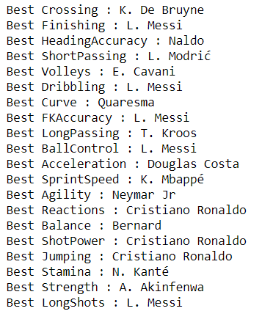
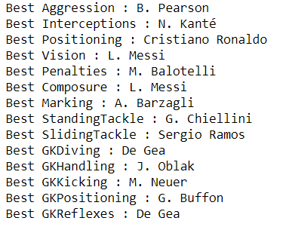
Top Players for each category

Slide 6
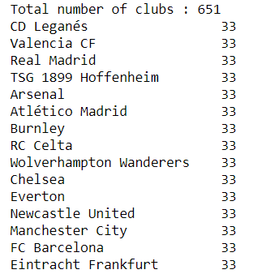
Clubs with Highest Number of Players

Slide 7
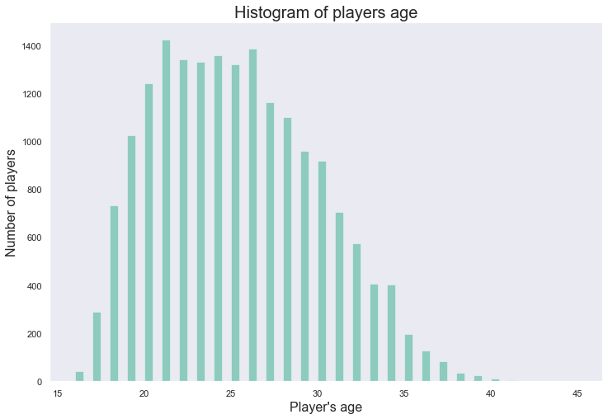
Descriptive Analysis – Player age

Slide 8
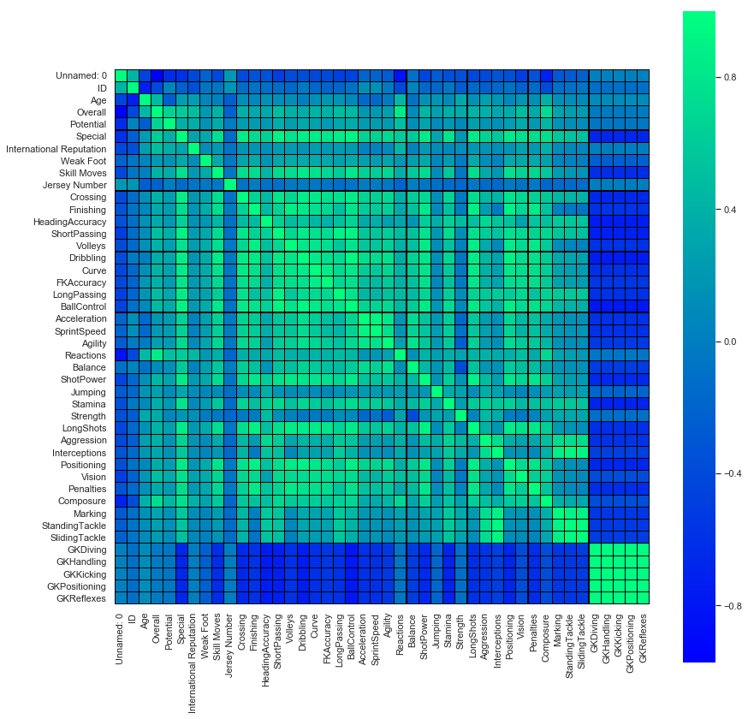
Correlation Heat map

Slide 9
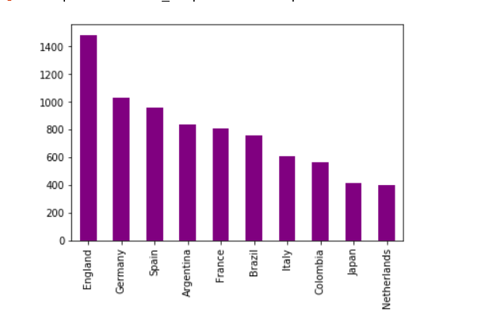
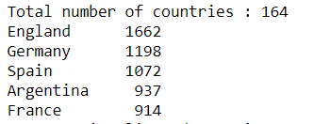
Distribution of Players among countries

Slide 10
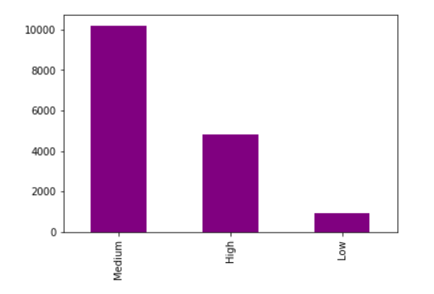
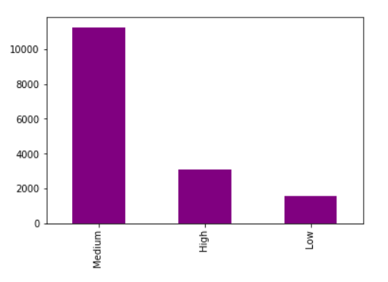
Play Style
Attack
Defense

Slide 11
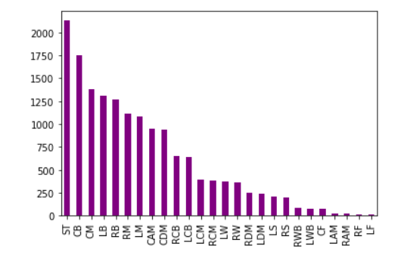
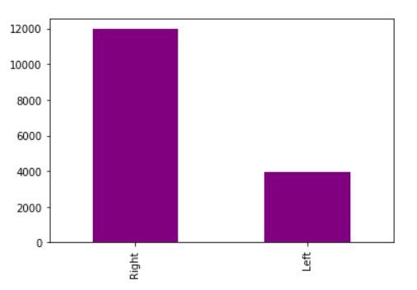
Position and player foot preference

Slide 12
Play Style
Attack
Defense

Slide 13
Feature Engineering
Encoding of Categorical Features
Categorical features are converted to numerical attributes using One-Hot encoding.
Removal of Insignificant Features
ID, Contract Valid Until features are removed due to their insignificance to the model
Normalization of Numerical Features

Slide 14
Prediction of Player Wage
Linear Regression
Best training score : 0.76
Best test score : 0.74
Ridge Regression
Best training score : 0.77
Best test score : 0.74
Best Parameters : alpha = 0.1

Slide 15
Prediction of Player Wage (Cont.)
Lasso Regression
Best training score : 0.78
Best test score : 0.75
Best Parameter: Alpha = 0.01
KNN Regression
Best training score : 0.81
Best test score : 0.76
Best Parameter : K = 4

Slide 16
Prediction of Player Wage (Cont.)
Decision Tree Regressor
Best training score : 0.88
Best test score : 0.86
Best Parameter : Maximum Features = 2, Minimum Sample Split = 5

Slide 17
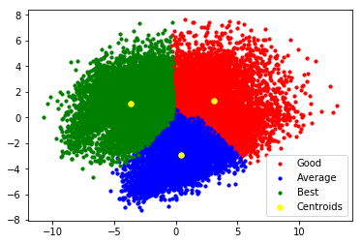
Cluster of players

Slide 18
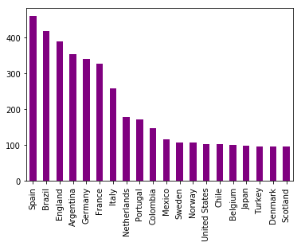
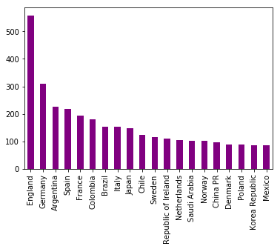
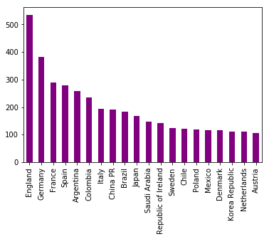
Nationality (Best vs Good vs Avg.)
Good
Average
Best

Slide 19
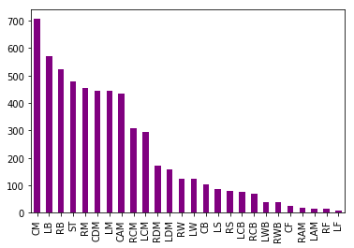
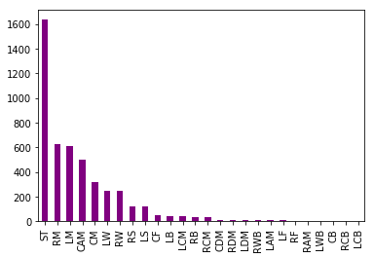
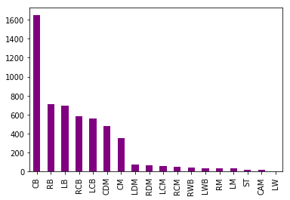
Player Position (Best vs Good vs Avg.)
Good
Average
Best

Slide 20
Thank You

